Slide 1
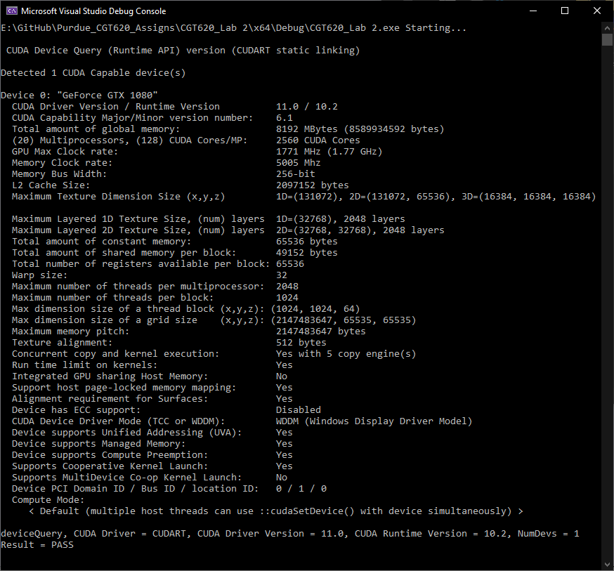
Device Query

Slide 2
